Slide 1
Regression

Slide 2
What is Regression??

Slide 3
What is Regression??
In general: Regression is return to a former or less developed state.
In medical terms: Sigmund Freud classified regression as a defence mechanism for coping with stress; where one reverts to an earlier, more childlike pattern of behaviour to cope.
In probability: Regression is a statistical measurement used in finance, investing, and other disciplines that attempts to determine the strength of the relationship between one dependent variable (usually denoted by Y) and a series of other changing variables (known as independent variables).

Slide 4
Regression
For classification the output(s) is nominal
In regression the output is continuous
Function Approximation
Many models could be used – Simplest is linear regression
Fit data with the best hyper-plane which "goes through" the points
For each point the differences between the predicted point and the actual observation is the residue
y
x

Slide 5
Regression
For classification the output(s) is nominal
In regression the output is continuous
Function Approximation
Many models could be used – Simplest is linear regression
Fit data with the best hyper-plane which "goes through" the points
For each point the differences between the predicted point and the actual observation is the residue
y
x

Slide 6
Regression
For classification the output(s) is nominal
In regression the output is continuous
Function Approximation
Many models could be used – Simplest is linear regression
Fit data with the best hyper-plane which "goes through" the points
For each point the differences between the predicted point and the actual observation is the residue
y
x

Slide 7
Simple Linear Regression
For now, assume just one (input) independent variable x, and one (output) dependent variable y
We will "fit" the points with a line (i.e. hyper-plane)
Which line should we use?
Choose an objective function
For simple linear regression we choose sum squared error (SSE)
Σ (predicted_{i} – actual_{i})² = Σ (residue_{i})²
Thus, find the line which minimizes the sum of the squared residues (e.g. least squares)
Notes:
Hyperplane for multiple linear regression

Slide 8
How do we "learn" parameters
For the 2-d problem (line) there are coefficients for the bias and the independent variable
Y=MX + C
M →Slope
C → Intercept

Slide 9
Multiple Linear Regression
In Multiple linear regression we have more independent variables
There is a closed form for finding multiple linear regression weights which requires matrix inversion, etc.
There are also iterative techniques to find weights
Notes:
Note target really is the point being regressed to each time. Now makes better sense since net is the output and we want to minimize error of the target.

Slide 10
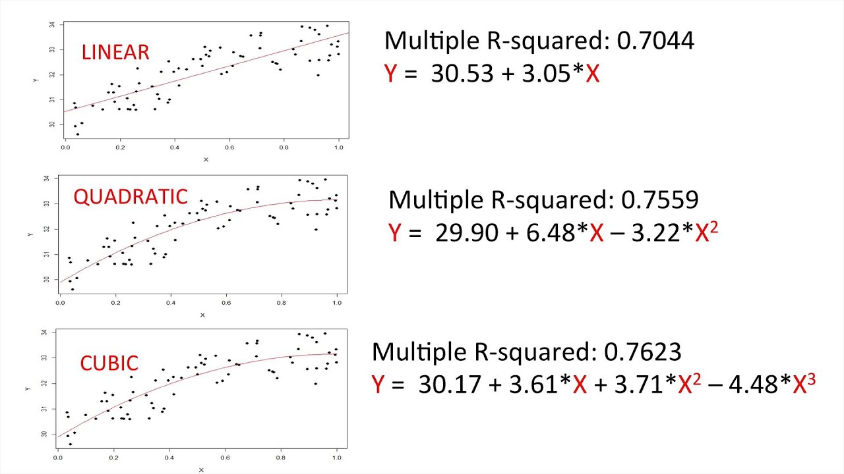
Polynomial Regression
Polynomial Regression is a form of linear regression in which the relationship between the independent variable x and dependent variable y is modelled as an nth degree polynomial.

Slide 11
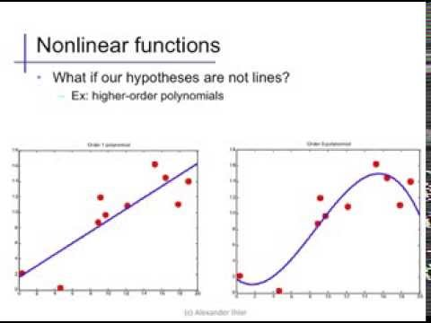
Non- Linear Regression
Nonlinear regression is a regression in which the dependent or criterion variables are modeled as a non-linear function of model parameters and one or more independent variables.

Slide 12
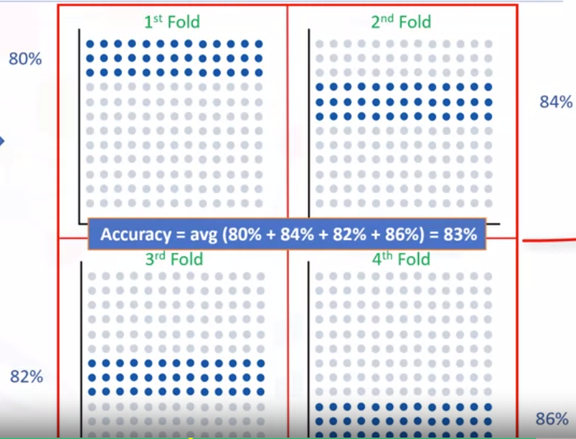
Evaluation metrics:
K-Fold cross validation

Slide 13
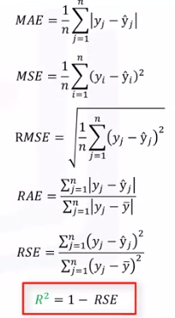
Evaluation metrics:
R2- Score
R-squared or R2-score is a statistical measure of how close the data are to the fitted regression line.
R2-score lies in between -1 and 1.
A Negative R2 means you are doing worse than the mean value.

Slide 14
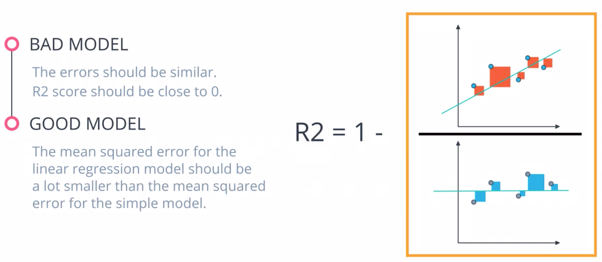
Evaluation metrics:
R2- Score

